Slide 1
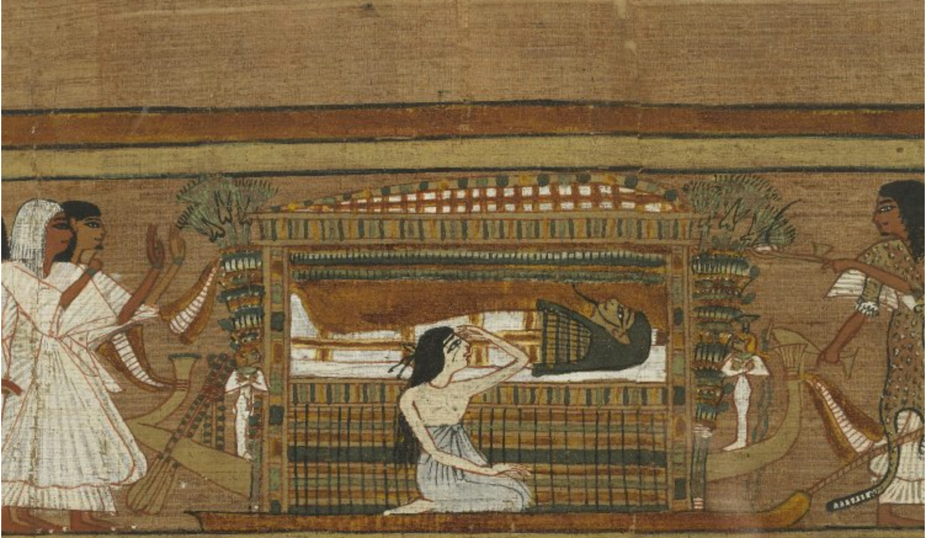

The Widow’s Lament
Iconography of Female Mourners in
Ancient Egyptian Funerary Rituals
Ariadne Argyros
Durham University, Dept of Archaeology ariadne.t.argyros@durham.ac.uk

Slide 2
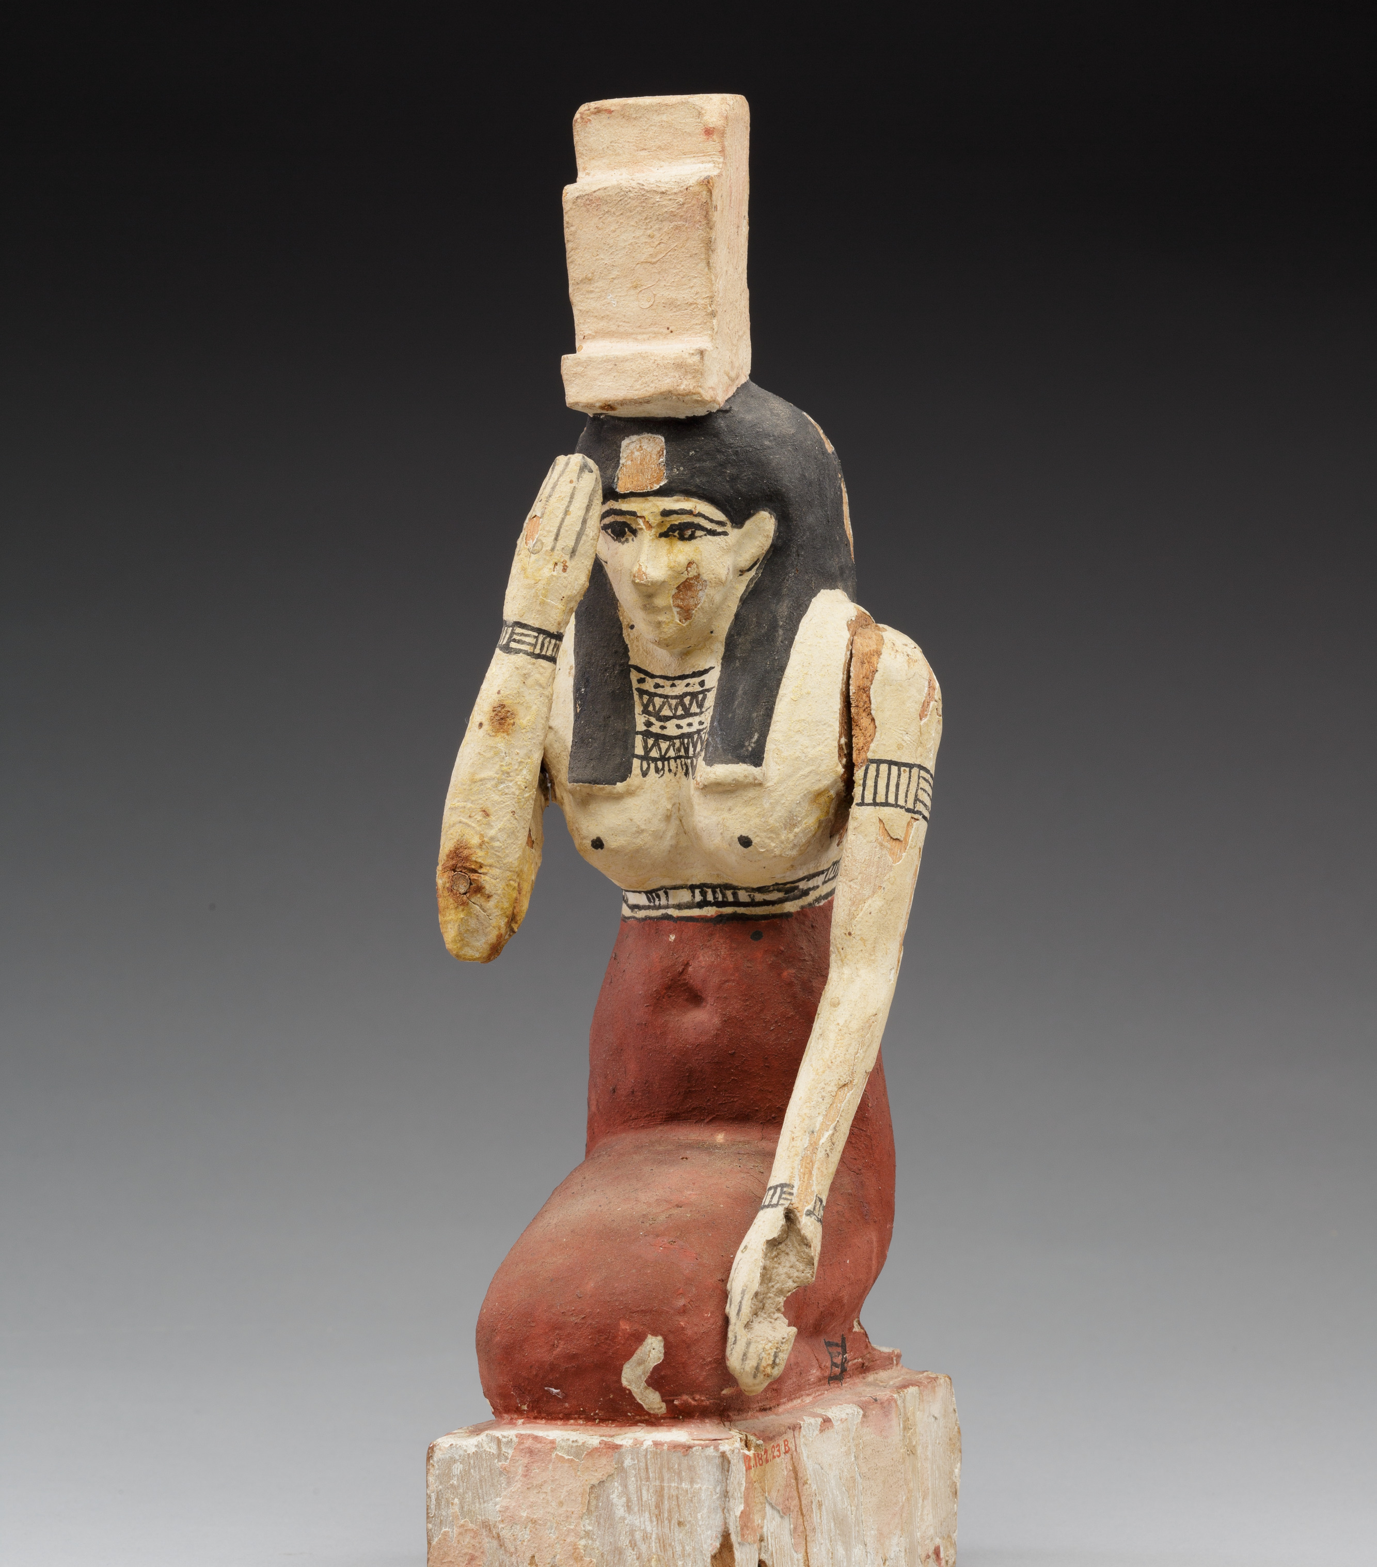
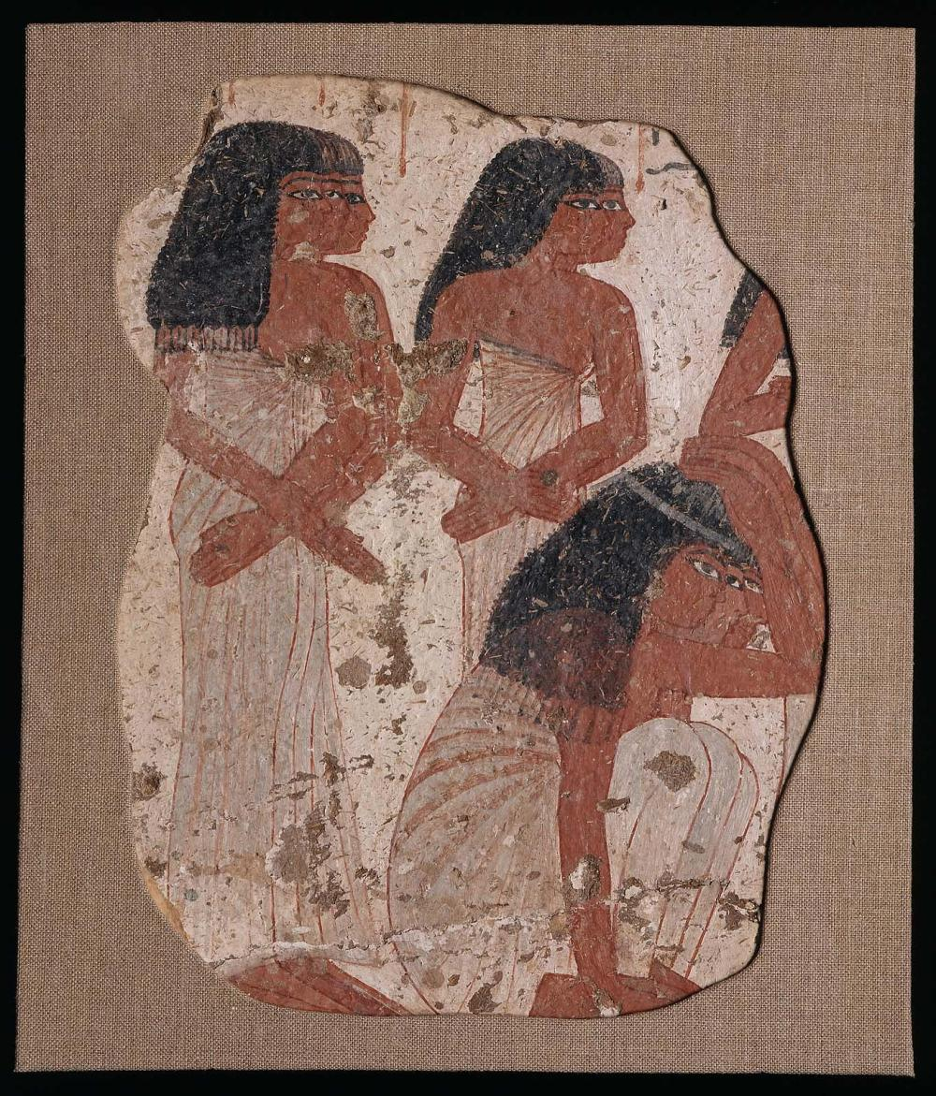
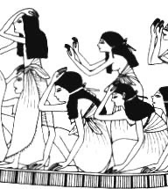
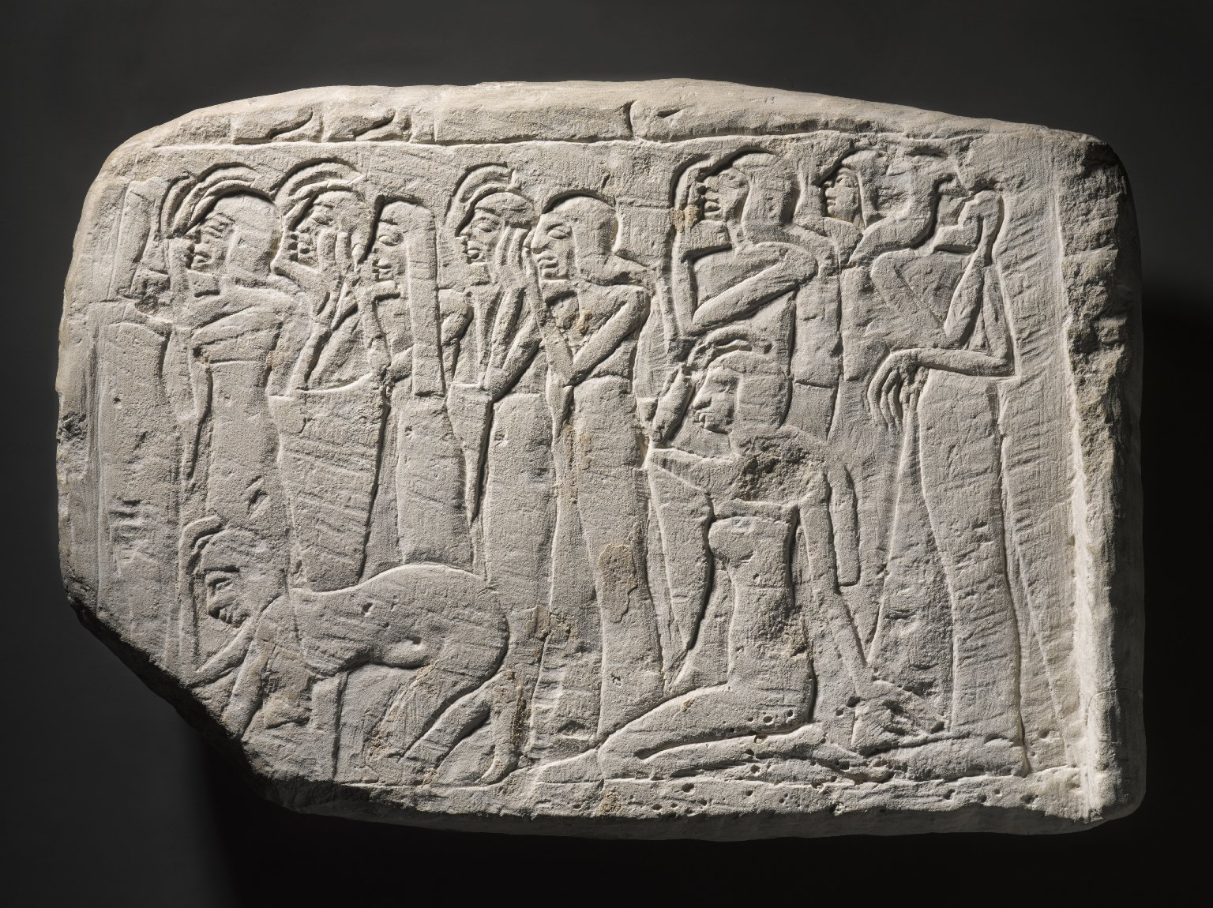
Who were they? What did they look like?
Women who mourned the deceased following a prescribed, rigid set of rules to assist in the transition of the dead to the afterlife
Divine (Dryt) and human mourners
Dress
  long sheath-like dress held up with one or two straps or knotted below breasts
  fillet tied around hair/wig
Typical gestures
  hand(s) on/reaching toward head
  Hand(s) at side
  ”Persian gesture”
  kneeling on or falling to the ground
  Throwing dust on heads

Slide 3
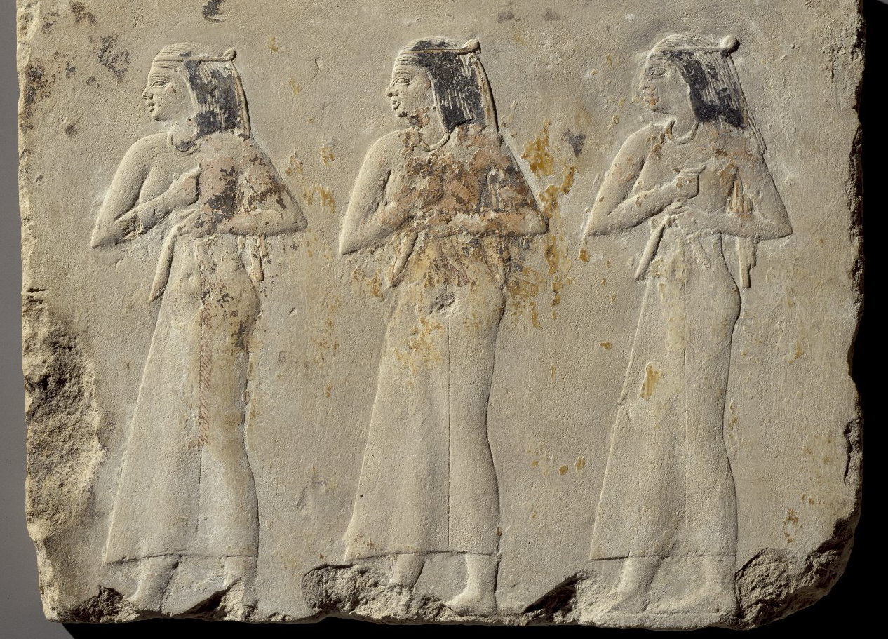
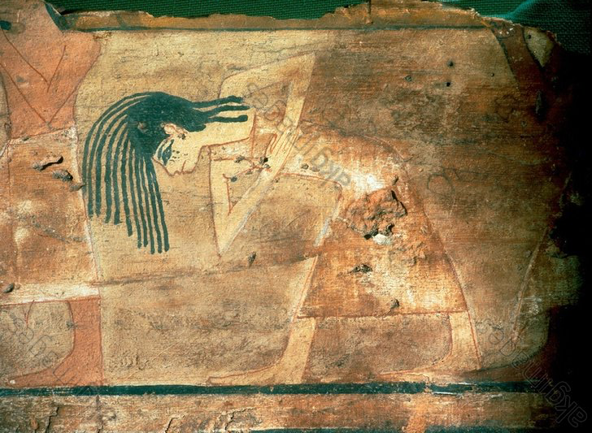
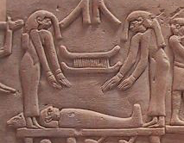
Who were they? What did they look like?
Behaviors and Actions
  Stoic
  Open-mouthed wailing
  Crying
  Baring/clutching the breast
  Beating the breast
  Flipping/pulling hair
  Throwing dust on their heads
  Scratching cheeks

Slide 4
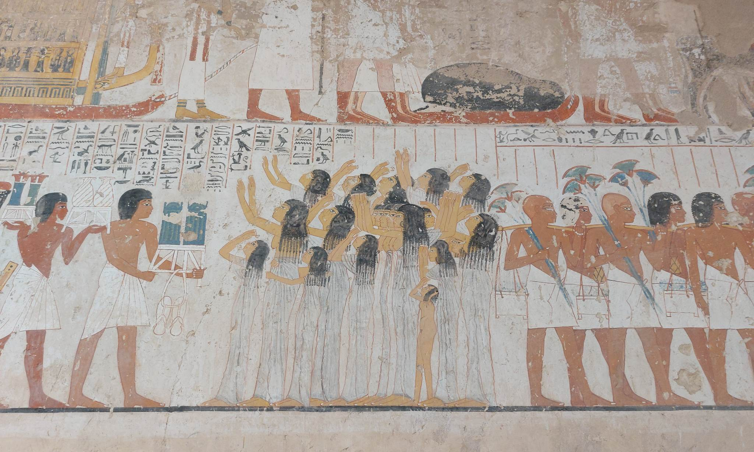
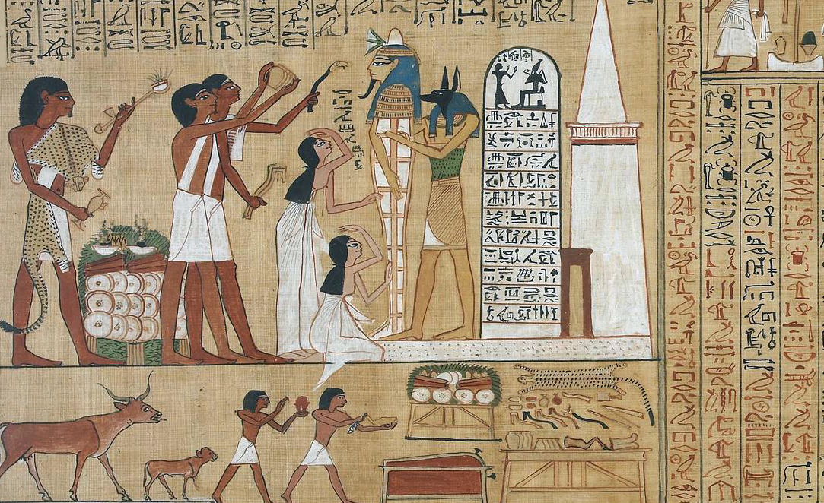
Decorum
Determines the content, composition, and placement of representational forms (Riggs 2013)
Violent displays of mourning appear to break the bounds of visual decorum
If chaos is enacted in a controlled, predetermined way, the ritual’s purpose be fulfilled without the danger of unbridled chaos

Slide 5
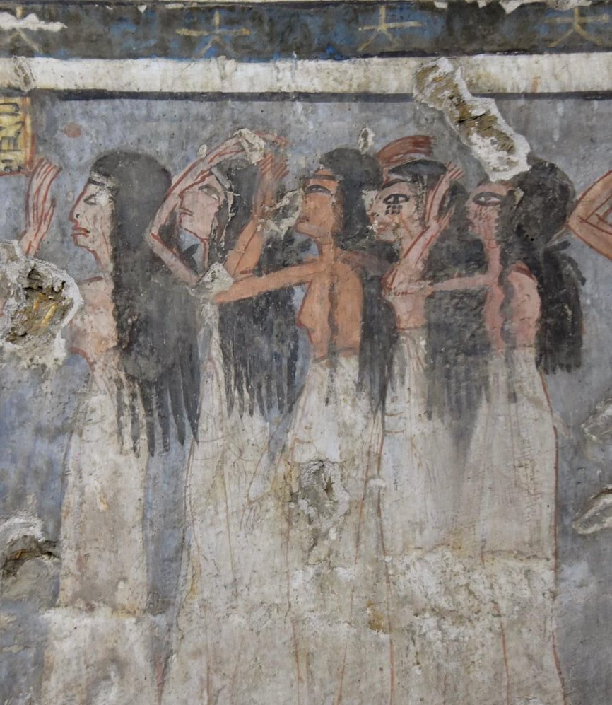
Scratching cheeks
Self-mutilation = literal and symbolic externalizations of grief
Expresses sorrow/trauma and provides emotional release
A material manifestation of pollution attached to death
Symbolic identification with the deceased, objectifying the stated yearning for reunion
  Pap. Berlin 3008, 2, 1-13
  Pap. Bremner-Rhind, 6.24-7.13; 12.9-12
  Pap. New York Met Museum 35.9.21, 5.8-9; 5.4-6; 5.11-13; 7.1-4

Slide 6
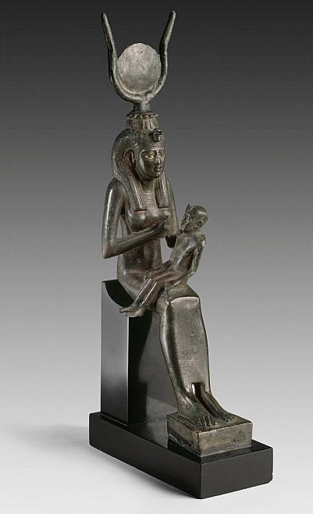
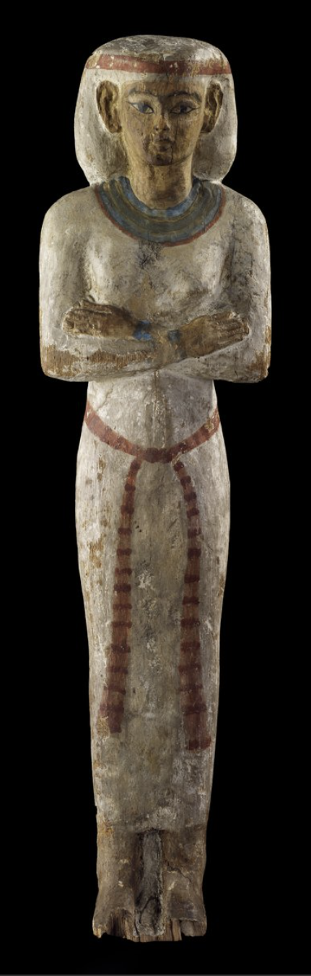
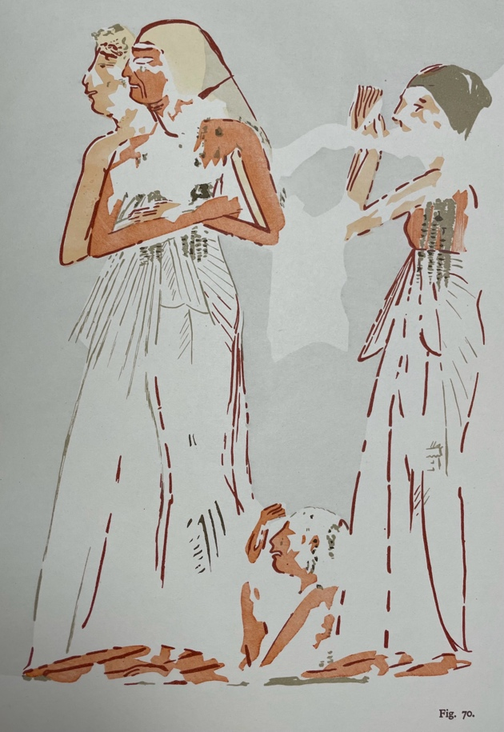
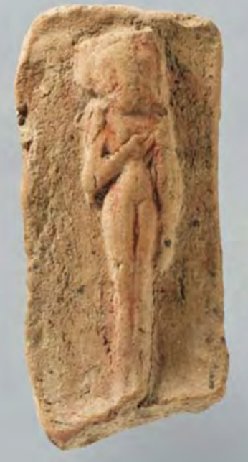
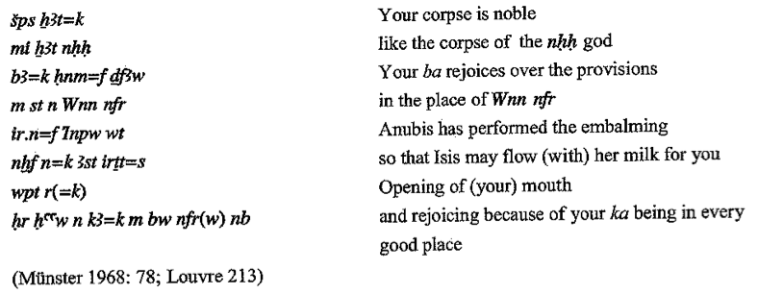
Baring/Clutching the Breast
Not only conveying depth of grief or illustrating indecorous behavior
Milk of a goddess imbued with divine power
Common offering to the dead
Deceased aligned with Osiris and the infant Horus
Allusions to fertility and birth, as well as a more generalized wish and desire for regeneration and rebirth

Slide 7
Baring/Clutching the Breast
Draws attention to the fertile value of the female breast
Reinforces revivifying function of the rites and the goddess’ roles therein
  PT 2089a – Isis grasps her breasts when the dead king reaches the afterworld
  Song of Nut originally chanted by a mournful Nut calling for the dead Osiris to nurse from her breast
  Louvre 213 describes the dead receiving the milk of Isis
  PT 535 – Isis sits down with her arms up and Nephthys seizes the tips of her breasts to revive their ‘brother’, Pepi I
  PT 413 – call upon Teti to raise himself upon receiving divine breast milk of Isis

Slide 8
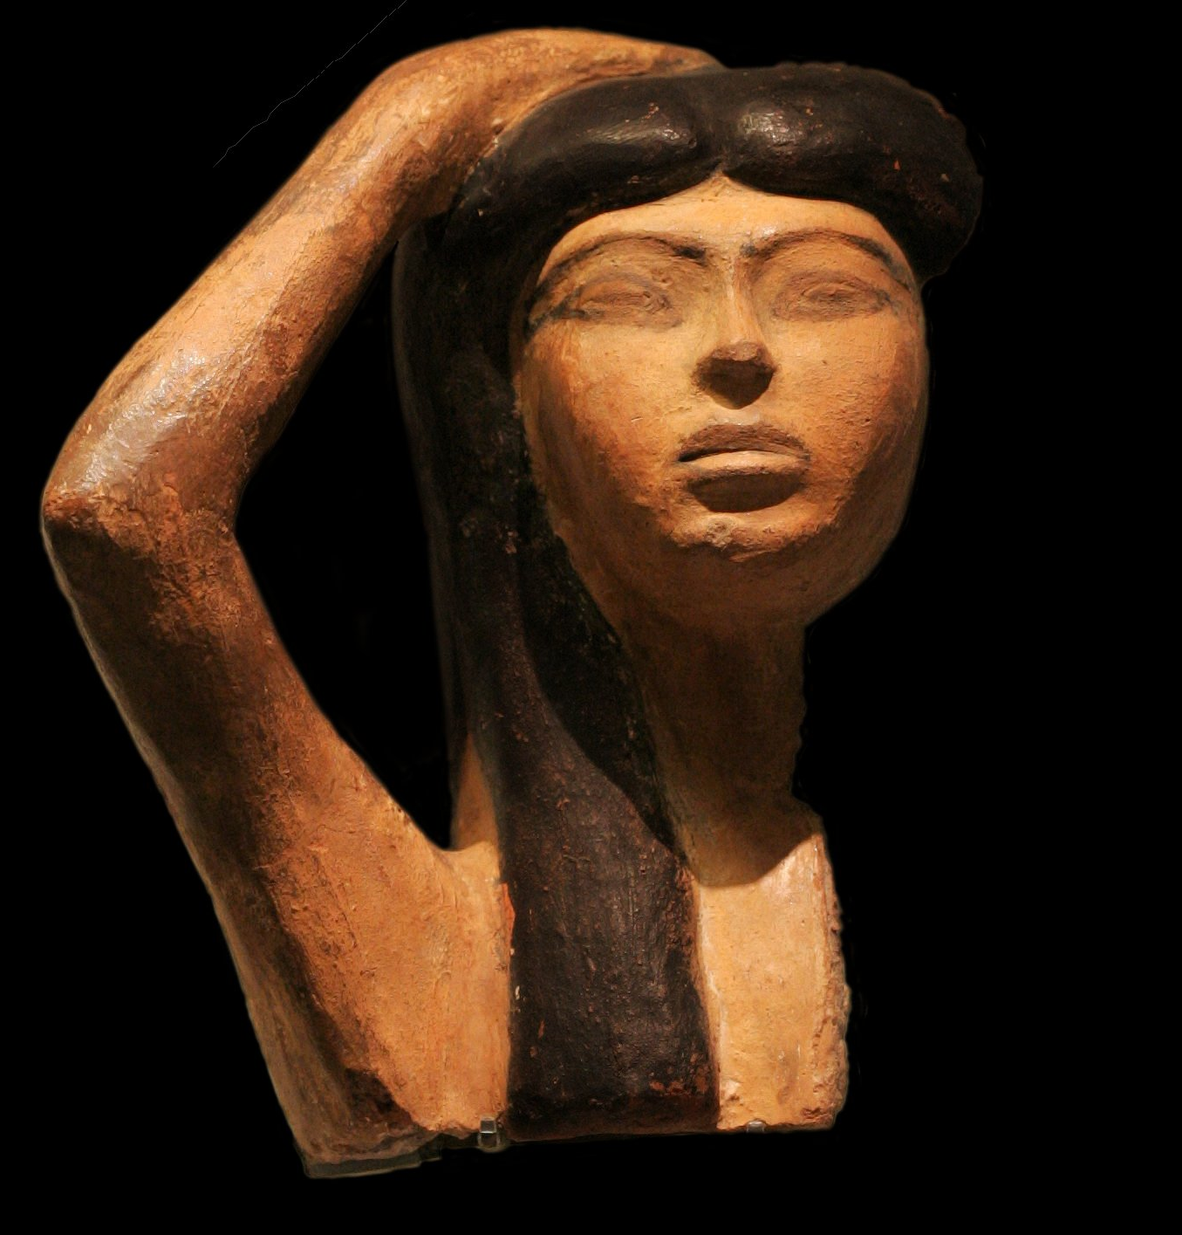
Why are they significant?
Pre-Osiris: bereft constantly worried about the immediate, tangible realities of death
Post-Osiris: mourners' laments became integral to transitioning the dead
Deceased’s fate was likened to Osiris’ fortune
Allowed for stabilization of emotions and relief from ambiguity around death and the hereafter
Represented pain, fear and insecurity as well as hope for resurrection
Facilitated transition of the dead into the afterlife
Helped them move into a new role in society

Slide 9
References
Assmann, Jan. Tod und Jenseits im alten Ägypten. München: Beck, 2001.
Corbeill, Anthony. “Chapter 3. Blood, Milk, and Tears: The Gestures of Mourning Women.” In Nature Embodied: Gesture in Ancient Rome. Princeton: Princeton University Press, 2004.
El-Shahawy, Abeer. The Funerary Art of Ancient Egypt: A Bridge to the Realm of the Hereafter. Cairo, Farid Atiya Press, 2005.
Ivanova, Maria. “Milk in Ancient Egyptian Religion.” Master’s thesis, Uppsala University, 2009.
Kucharek, Andrea. “Wohltuende Tränen: Zur Funktion des Weinens in der altägyptischen Totenklage.” In Die Welt der Rituale: Von der Antike bis heute, (eds.) C. Ambos, S. Holz, G. Schwedler, and S. Weinfurter, 15–21. Darmstadt: WBG, 2005.
—. “Mourning and Lamentation on Coffins.” In Ancient Egyptian Coffins, (eds.) John H. Taylor and Marie Vandenbeusch, 77-116. Leuven: Peeters, 2018.
Miller, Barbara B. “Women, death, and mourning in the ancient Eastern Mediterranean world.” Ph.D. diss, University of Michigan, 1994.
Pehal, Martin and Markéta Preininger Svobodová. “Death and The Right Fluids: Perspectives from Egyptology and Anthropology.” Journal of Ancient Egyptian Interconnections, vol. 17 (2018): 114-136.
Riggs, Christina. “Mourning Women and decorum in ancient Egyptian art.” In Decorum and Experience: Essays in Ancient Culture for Prof. John Baines, (eds.) E. Frood and A. McDonald, 156-162. Oxford: Griffith Institute, 2013.
Sourvinou-Inwood, Christiane. "A Trauma in Flux: Death in the 8th Century and After." The Greek renaissance of the eighth century BC: tradition and innovation (1983): 33-48.
Spieser, Cathie. “Birth and Rebirth in Ancient Egypt”. ANE Today, Vol. 7, No. 8 (2019).
Verbovsek, Alexandra. "The correlation of rituals, emotions, and literature in ancient Egypt." In Ritual dynamics in the ancient Mediterranean. Agency, emotion, gender, representation, (ed.) A. Chaniotis, 235-262. Stuttgart: Franz Steiner, 2011.
Werbrouck, Marcelle. Les Pleureuses dans l’Egypte Ancienne. Bruxelles: La Fondation égyptologique Reine Elisabeth, 1938.

